Slide 1

Ebola epidemic in the DRC: My observations & reflections
On behalf of the Africa CDC – June 2026
Salim S. Abdool Karim, FRS
Yusuf Hamied Chair in Global Health & Director: CAPRISA Professor of Global Health, Columbia University
Chair: Africa CDC’s Emergency Consultative Group
Special Advisor on pandemics to the Director-General of the World Health Organisation Adjunct Professor of Immunology and Infectious Diseases, Harvard University
Adjunct Professor of Medicine: Cornell University
Pro Vice-Chancellor (Research): University of KwaZulu-Natal

Slide 2
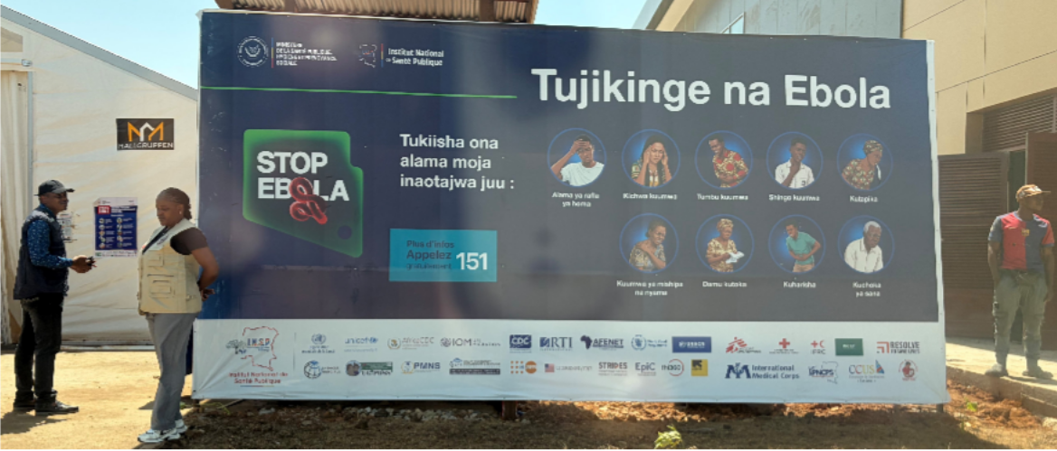
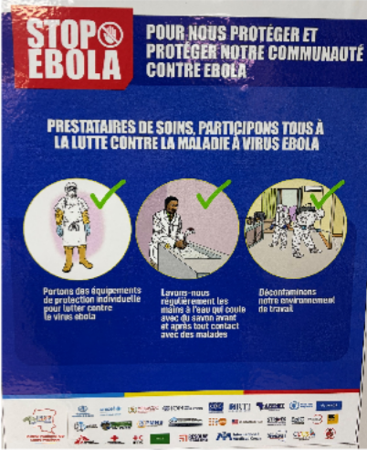
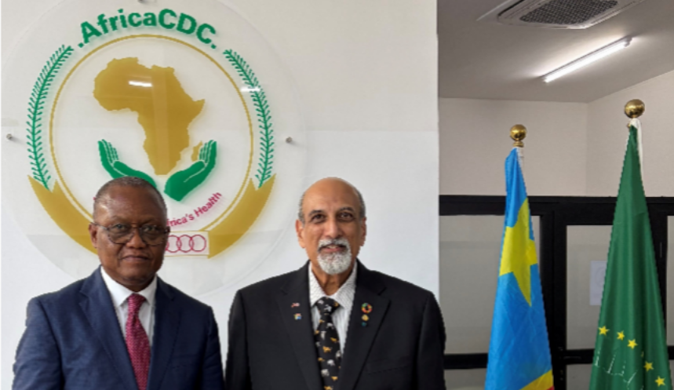
Ebola in DRC – Response progress? What is needed?
782 confirmed cases – 13 June
181 confirmed deaths - 13 June
17 May PHEIC declared
18 May PHECS declared
On behalf of the Africa CDC, I went on an emergency trip to the Democratic Republic of Congo (DRC) to help with the response to the Ebola epidemic.
As I had never been to the DRC before, my purpose was to understand in some detail the progress in the Ebola response and how I could help. In the following captioned photos, I am sharing what I learnt from being in heart of the Ebola response.
With the Head of Africa CDC in the DRC.

Slide 3
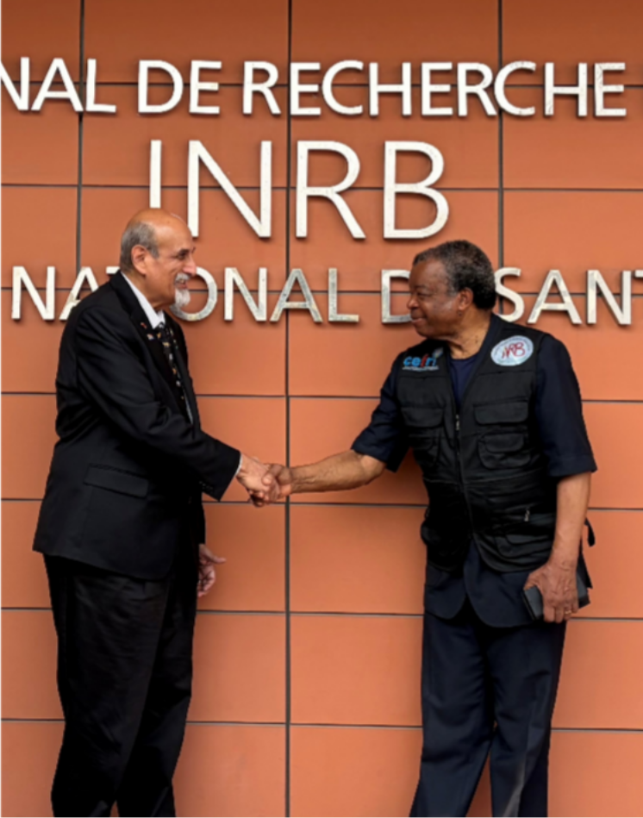
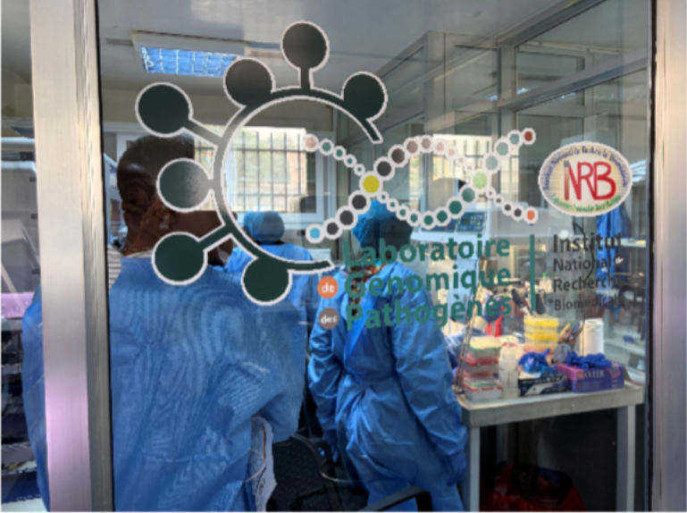
A visit to INRB – the DRC’s national laboratory
I started at the laboratory of my friend Professor Jean-Jacques Muyembe, Head of INRB, the national DRC laboratory in Kinshasa. Prof Muyembe discovered the first cases of Ebola and sent their specimens to my close friend, Prof Peter Piot in Belgium, who first isolated Ebola virus. They have jointly just
received the Virchow prize.
INRB has an impressive lab geared up for Ebola. They run several PCR platforms and several RADIONE pan- Ebola rapid diagnostic machines but most process only 1 sample at a time. So, they depend instead largely on lab-based PCR testing.
The INRB gene sequencing lab’s capabilities are impressive (above)

Slide 4
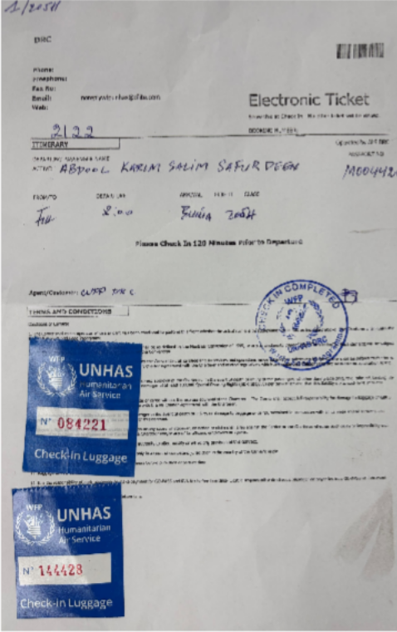
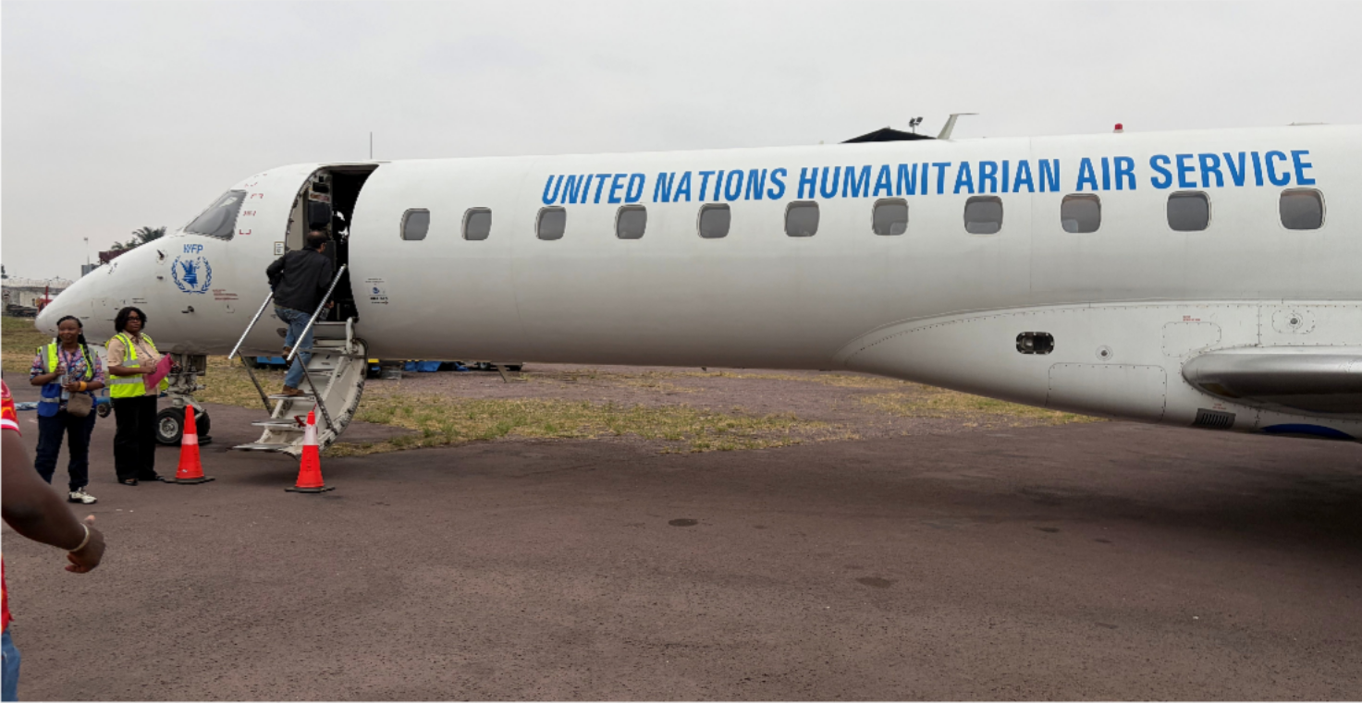
UN Humanitarian Air Services Flight # Ebola.1
Next stop - Bunia. Since Bunia is the epicenter of the Ebola epidemic, its airport is closed for commercial flights. I had to fly out of a makeshift UN terminal in Kinshasa airport to catch the UN special flight to Bunia that is restricted to those on “mission”. It was a United Nations Humanitarian Air Services (UNHAS) plane, flight number Ebola.1 / 205H

Slide 5
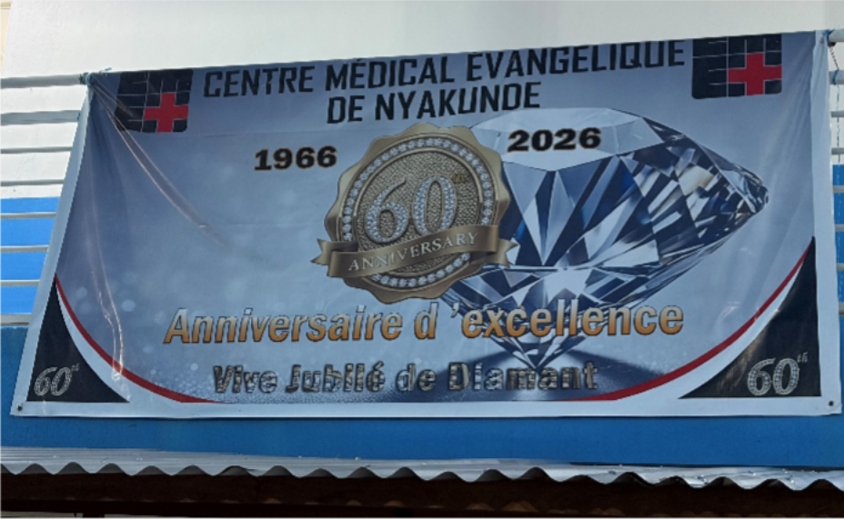
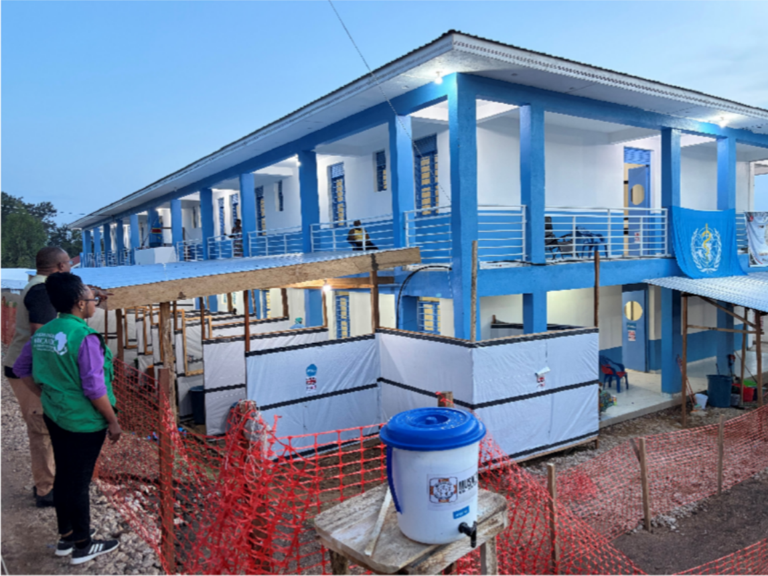
Evangelical: Bunia’s large Ebola treatment hospital
On arrival in Bunia, Dr Yap Boum, who leads the Africa CDC Ebola response team whisks me away to see 2 Ebola Treatment Centres. Evangelical Hospital, a government hospital which was missionary previously, is one of the largest for Ebola patients in Bunia – it has allocated 80 beds for Ebola.
Note: the bucket with a tap for washing hands before entry. The white plastic sheeting on the ground floor is the PPE doffing area when exiting the Ebola section.

Slide 6
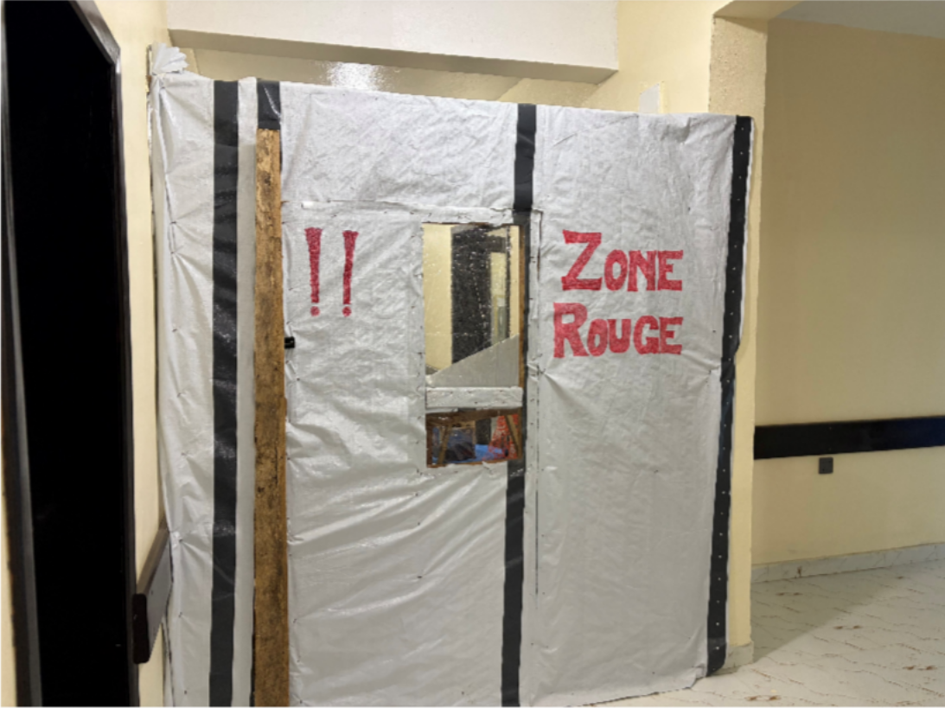
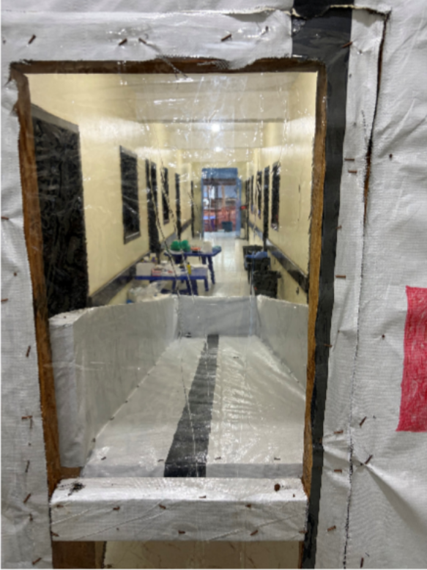
The Red Zone in Evangelical Hospital
About half the building has been cordoned off as Red Zone (Zone Rouge in French). With PPE donned, staff enter the Red Zone through a protected entrance. The chute in the close up of the transparent window is to send food, medicines, clothes, etc from the green zone to the red zone. With so much of the hospital dealing with Ebola, other health care services are unfortunately compromised.

Slide 7
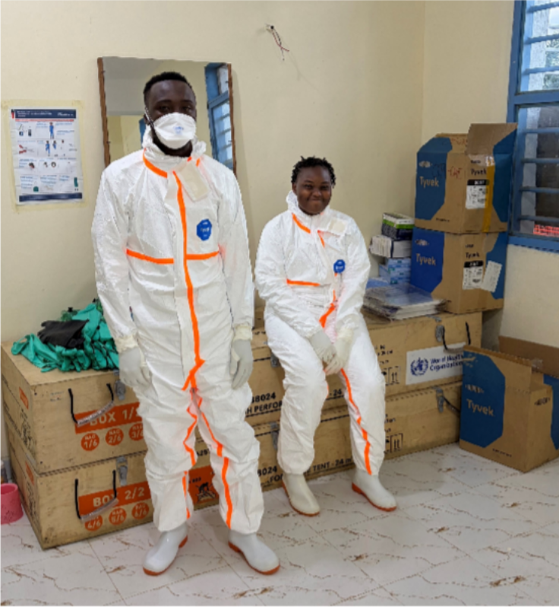
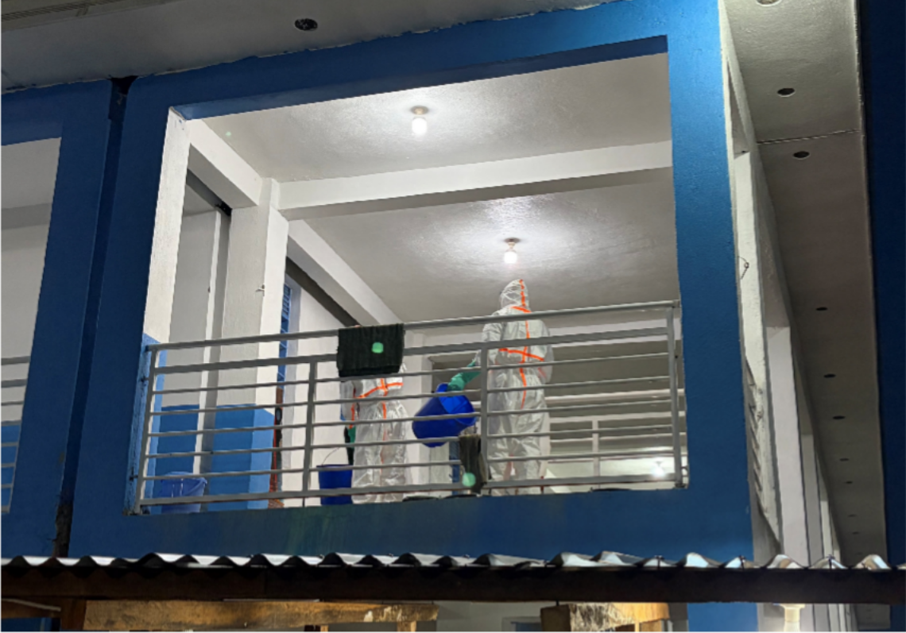
Staff preparing to enter The Red Zone
When I got there, two staff were busy donning PPE in the room demarcated for this purpose. They were not hesitant or concerned, just smiling as they prepared to enter the Red Zone. Above right shows both of them at work in the Ebola wards.

Slide 8
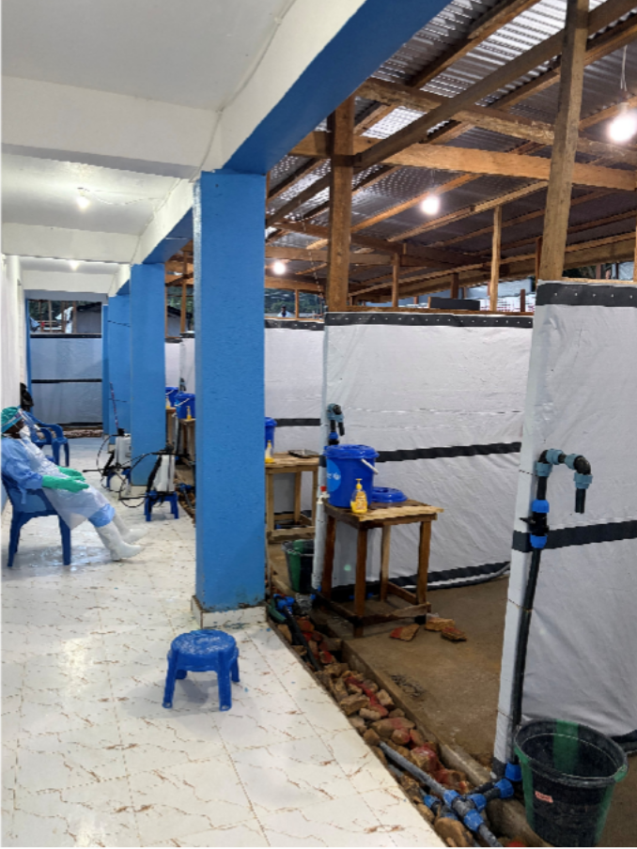
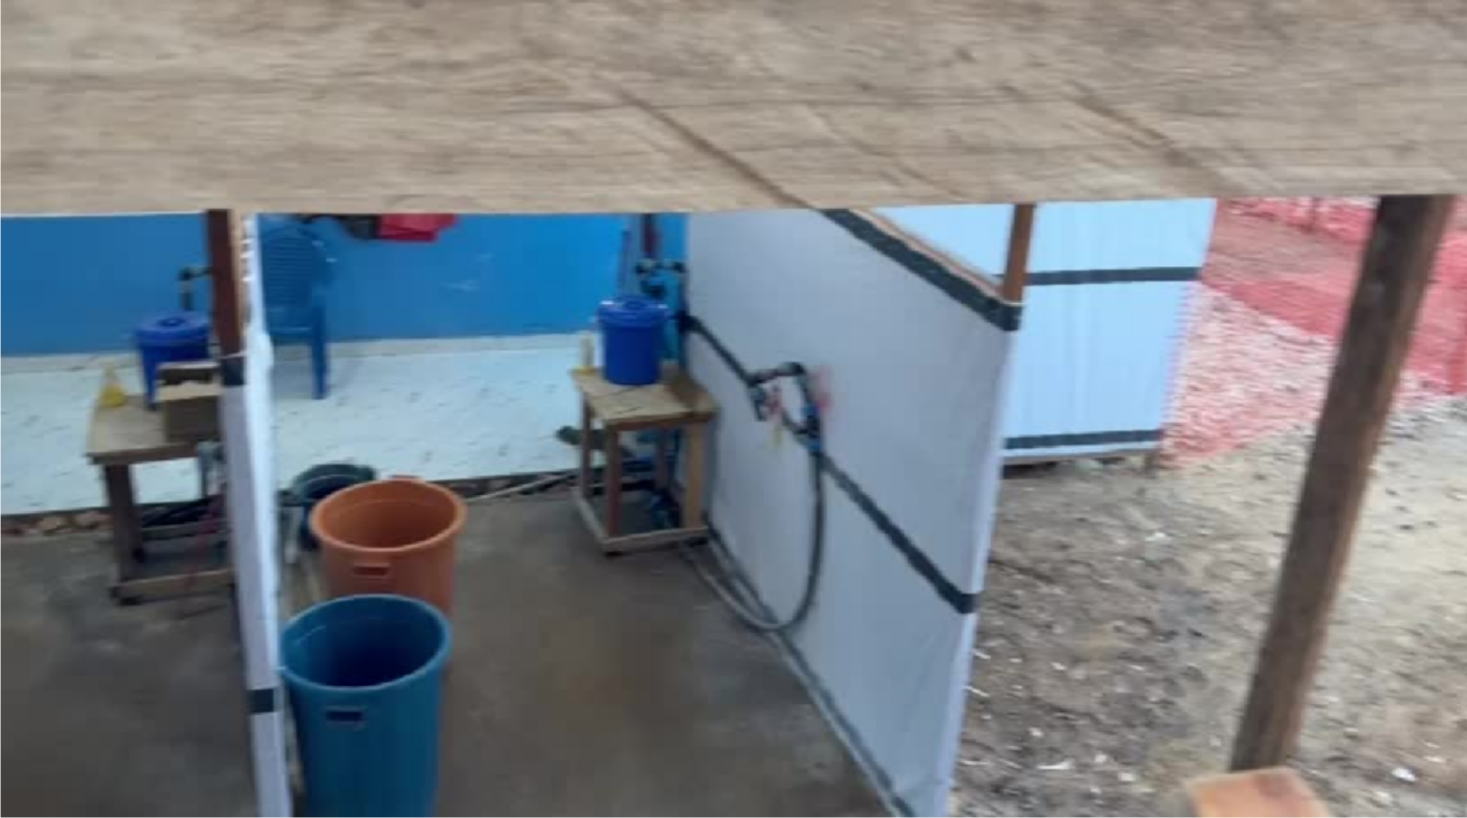
Ebola risks for healthcare workers – doffing PPE
To exit the Red Zone, staff pass through the cubicles for PPE removal (doffing) — removing PPE is one of the riskiest steps, as the gloves & gowns have usually been in direct contact with patients.
Click on the video on the right above to see the PPE doffing area in action.

Slide 9
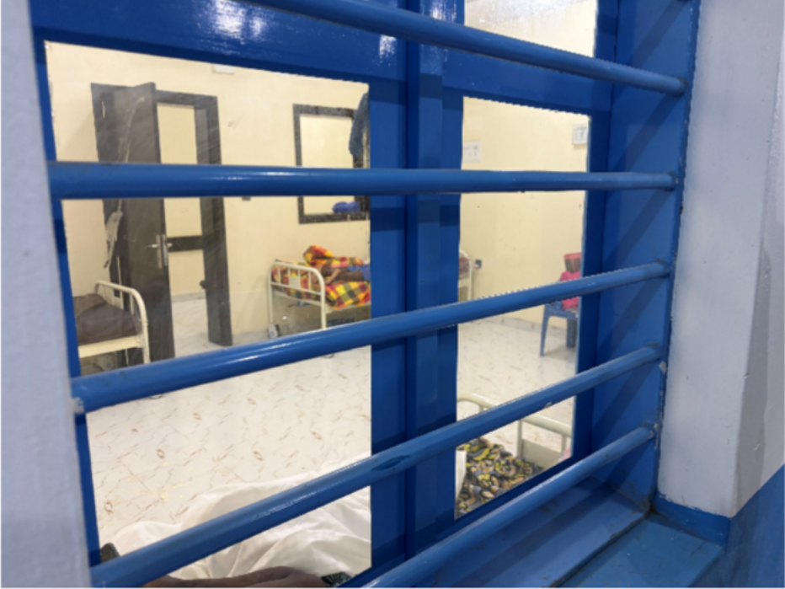
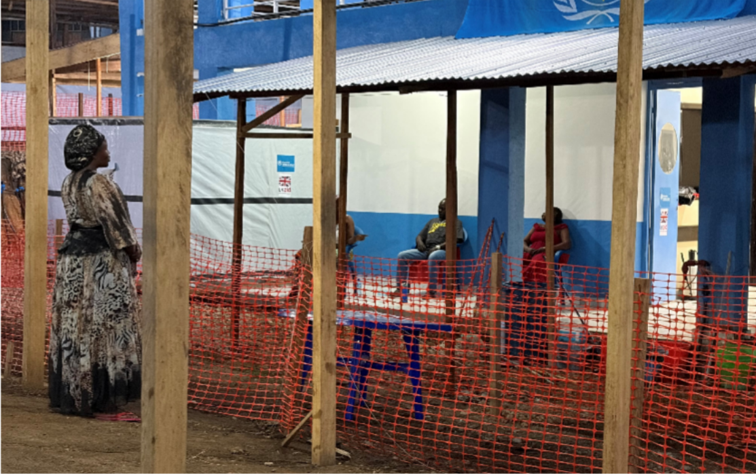
Patients in the Ebola wards & their visitors
It is incredible to see how the Ebola wards are organized. Confirmed Ebola patients are kept in individual wards or wards of 4 or 6. Suspected Ebola patients are kept in individual wards. In the photo above right, the lady standing on the left is a visitor – a relative of a patient with Ebola. She talks to the patients across the fence. A distance of >2m is considered safe for interaction with Ebola patients. The 3 ladies sitting on the stoop are Ebola patients who join in the chat with the visitor.

Slide 10
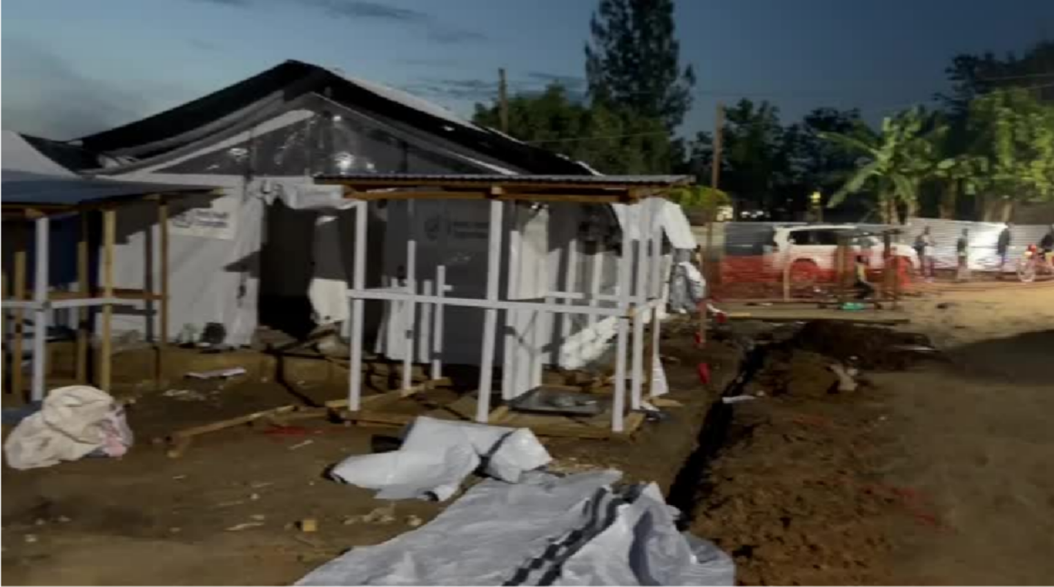
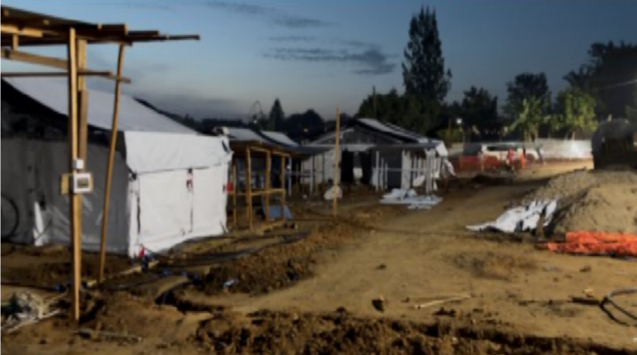
New Ebola isolation wards being built at the hospital
Right next to the Red Zone at Evangelical hospital, WHO is building several makeshift Ebola wards. These are mostly individual wards, mainly for suspects as confirmed patients are usually kept in communal wards. Click on the video above right to see the impressive WHO teams building these new facilities into the night.

Slide 11
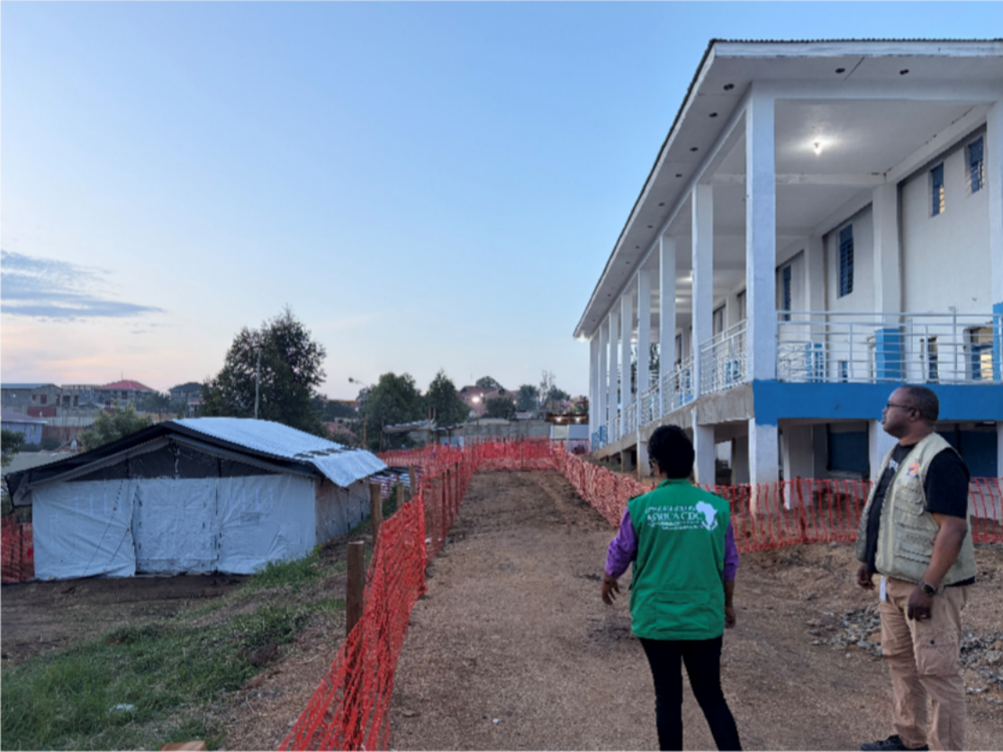
The grim reality is evident – though not obvious
Dr Kyeng Mercy, chief of surveillance for Africa CDC and Dr Settu of ALIMA (a sister organization to MSF) show me the makeshift mortuary tent at the back of the hospital. Several times I heard people use an acronym “SDB” – new to my vocabulary. I learnt that the International Red Cross and FHI360 are taking the lead on “Safe & Dignified Burial” (SDB). They have several community health workers monitoring for deaths in the community and they then go and help the families for an SDB of their loved one. They explained to me that families want bags where the area covering the face is transparent. The families don’t like the full black bags being used – which has led to some community resistance to SDB! I also felt that I would want to see the face of a loved one a last time. Even burials are a challenge here…

Slide 12
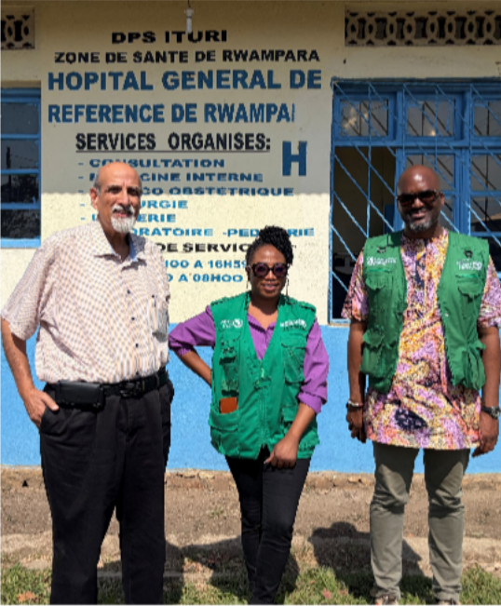
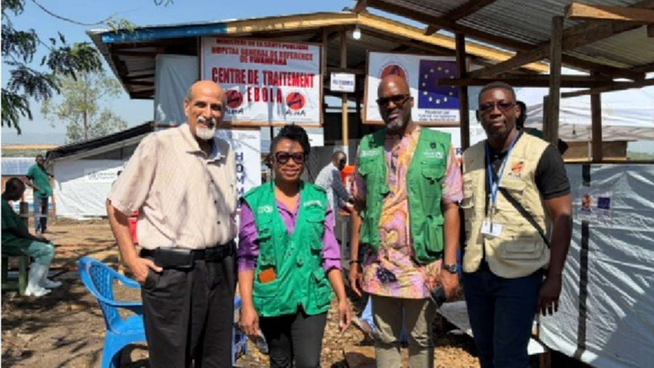
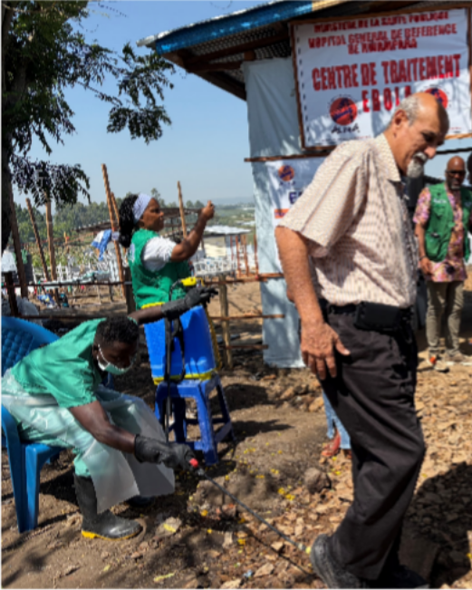
Ebola treatment Centre – Rwampara Hospital
I went with Dr Yap Boum and Dr Kyeng Mercy of Africa CDC and Dr Papys Lame Musey of ALIMA (Alliance for International Medical Action) to Rwampara hospital - a less resourced hospital than Evangelical. Rwampara saw its first Ebola patients in early May. Before we entered the Ebola ward zone, we have shoes sprayed and complete WASH procedures.

Slide 13
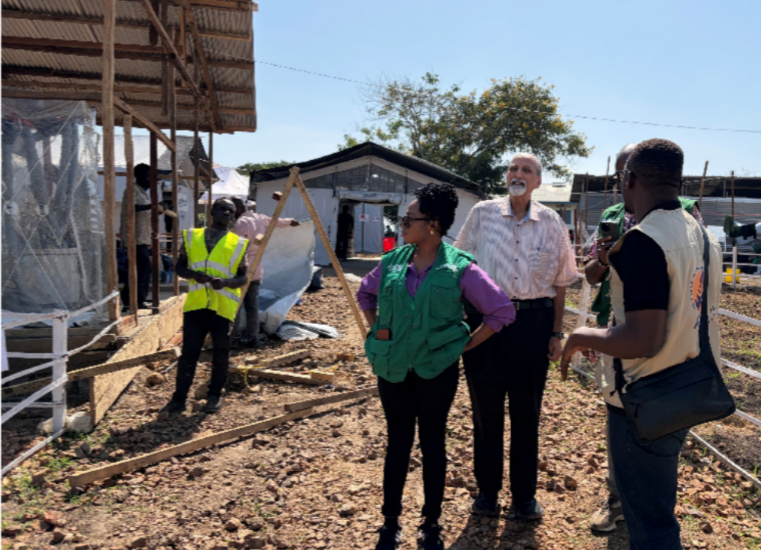
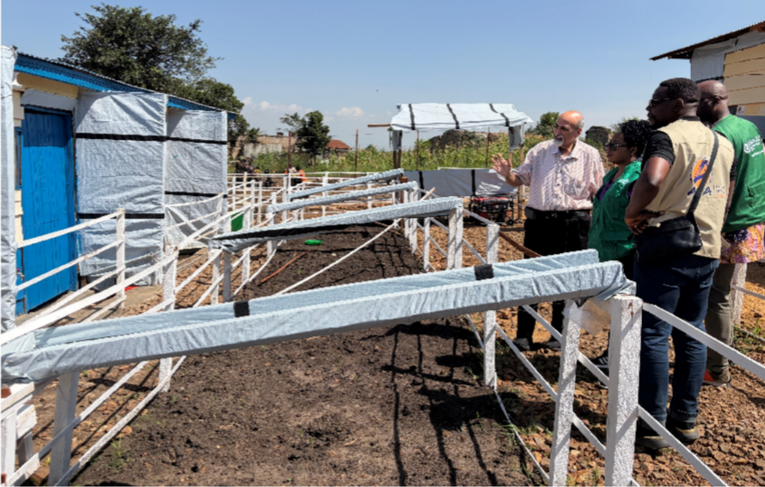
Rwampara’s 2 different types of isolation wards
ALIMA is building transparent plastic bubble-like cubicles for Ebola patients (photo left). Rwampara had a few isolation wards from the 2014 epidemic. We are standing (photo right) in the green zone next to those wards – this is where staff and visitors can talk to patients (1 per ward) safely and there is a chute to pass food, clothes, etc to the patients.

Slide 14
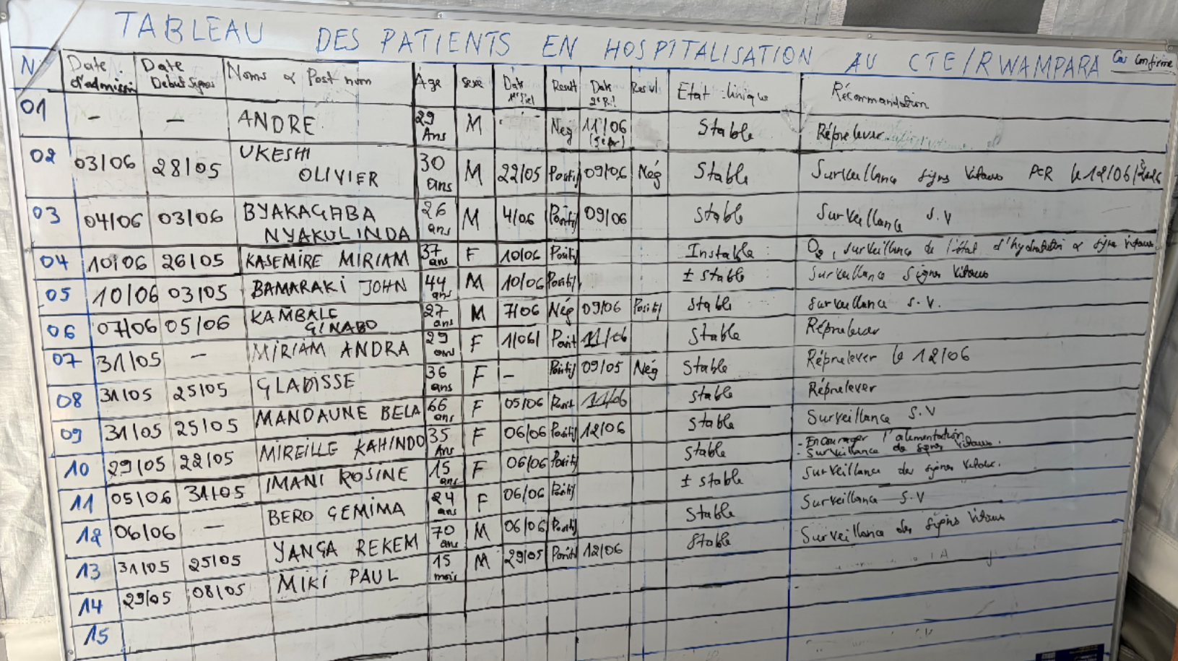
Epidemiology in action – tracking patient’s progress
Both Evangelical and Rwampara hospitals keep epidemiological and clinical data on white chalk boards, keeping track of each patient.
Unfortunately, the hospitals do not have computerized records or electronic means to capture their data.
It was quite impressive to see how much data is being collected manually meticulously.
Note: patient names have been blacked out

Slide 15
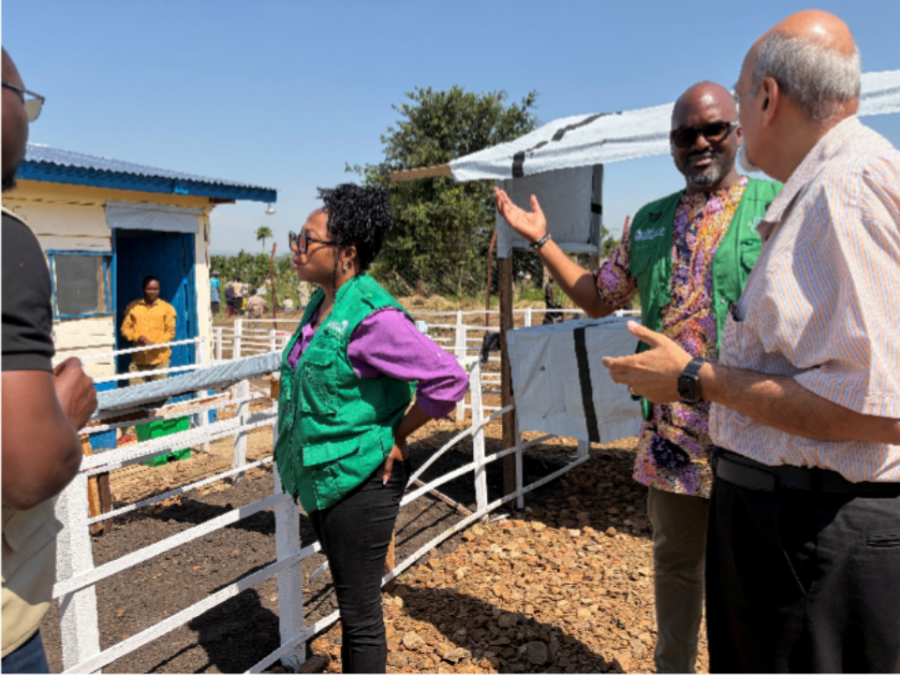
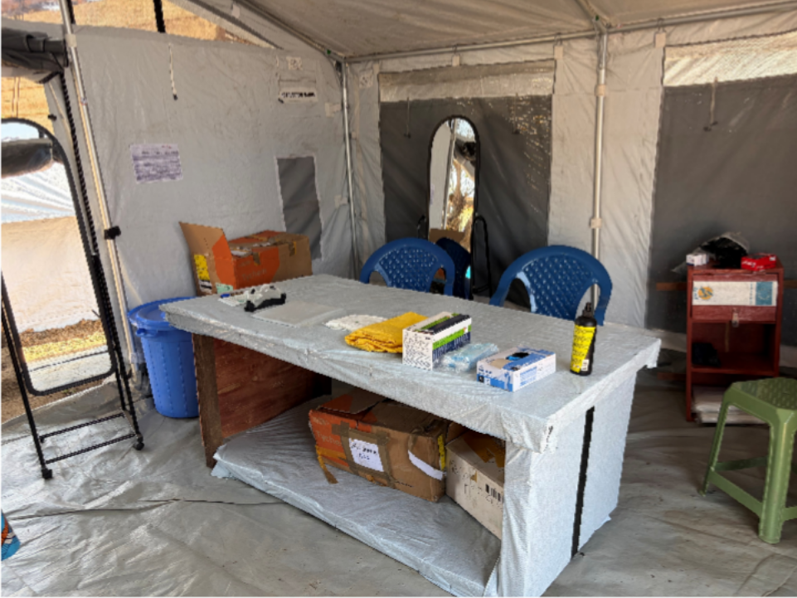
Talking to Ebola patients – isolation is difficult!
As expected, isolation is quite difficult for patients. Of the 18 Ebola patients in Rwampara hospital, 5 are medical staff including 2 doctors and an anaesthetist. It was heartbreaking to see them in the isolation wards. I appreciated the opportunity to speak with them from the green visitors zone. To actually go into the Ebola wards, medical staff enter the red zone after donning PPE. The photo above right is the PPE donning tent with a mirror and an assistant to help put on the PPE.

Slide 16
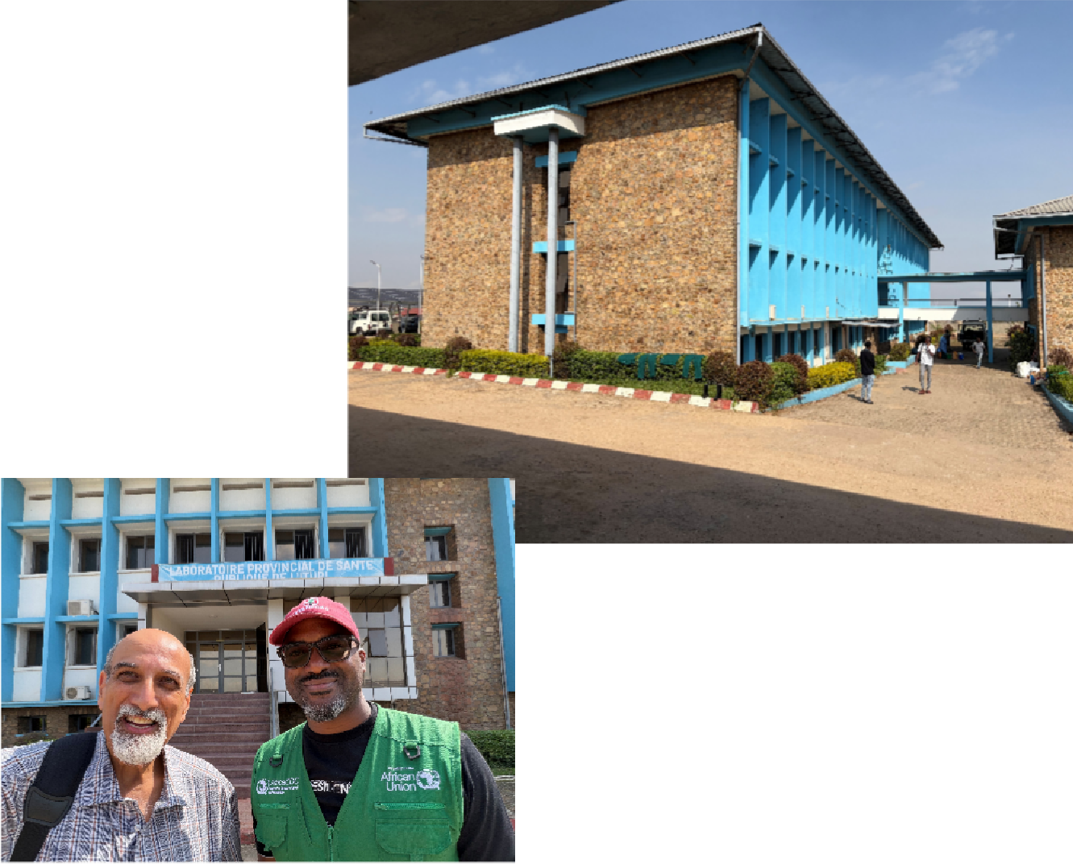
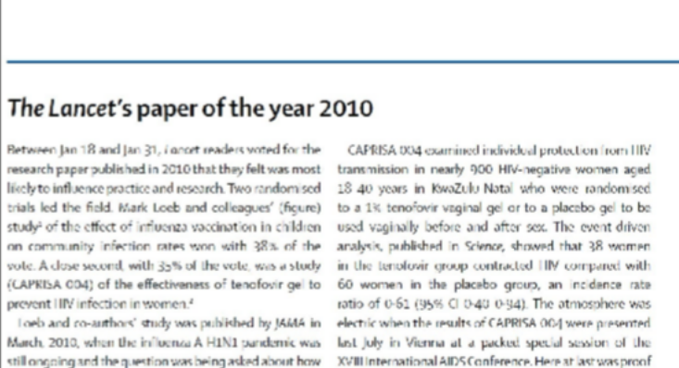

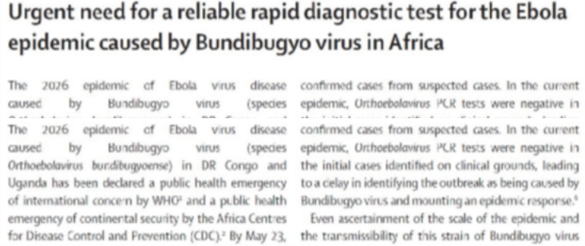
Ebola rapid diagnostic tests are urgently needed
A major problem at both hospitals was keeping large numbers of suspected Ebola cases in individual isolation wards to avoid nosocomial transmission – there are simply not enough wards for this. Since Ebola presents with clinical features of other common infections, there are many patients considered suspected cases. Waiting for their lab results increases the demand for single isolation wards. We highlighted this problem in a Lancet Commentary (below).
So, Yap Boum & I go the next day to the Bunia lab - it is a satellite lab to Jean-Jacques Muyembe’s INRB. The building is huge and was recently renovated by the World Bank for mpox testing.

Slide 17
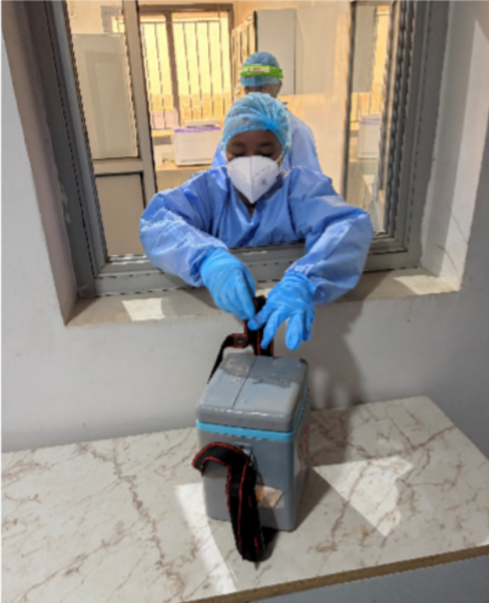
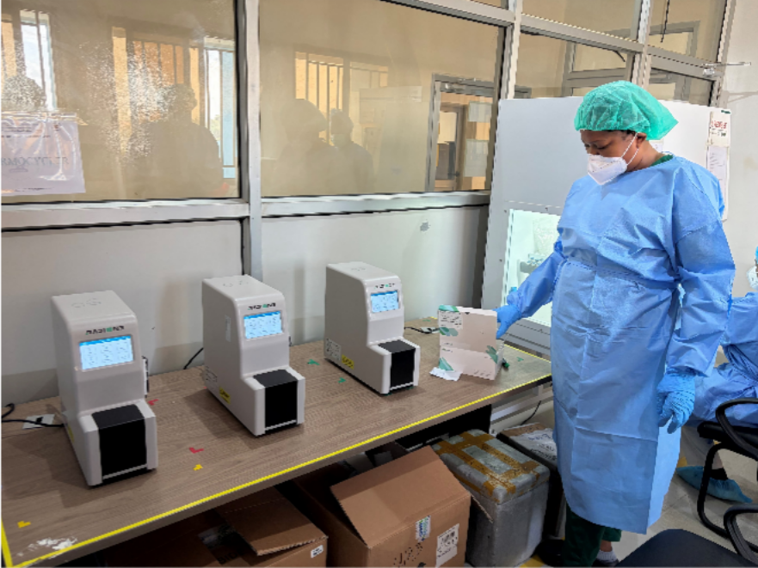
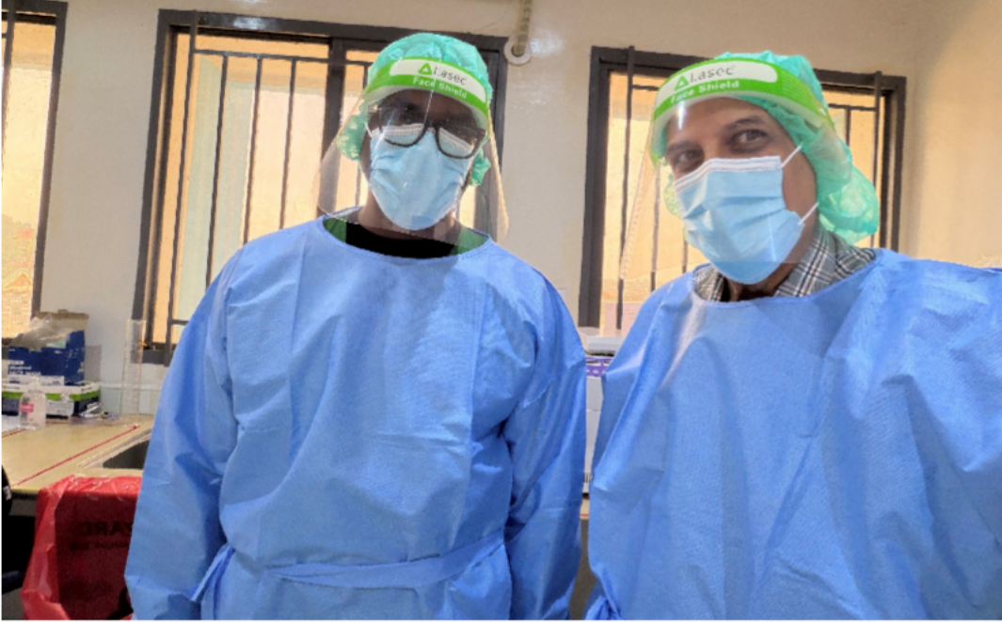
The Bunia lab: Key to the Ebola response
After donning our PPE, we went into the main Ebola lab with Dr Wawima, a Congolese doctor with a PhD in Virology from Leuven in Belgium, who is taking up the diagnostic problems head-on.
Procedures are exemplary from the time the samples arrive from the hospitals. Since he has only 4 RADIONE machines to do a few rapid tests, main Ebola testing is on 92 sample 2-hour PCR runs.
He needs more rapid test machines so that they can be located at the hospitals for same-encounter diagnosis. Leaving INRB Bunia, I can confidently say that this is a very capable top-notch lab. Ituri province is well served with this gem.

Slide 18
A Trifecta: Conflict, humanitarian crisis & epidemics
I had 2 fascinating engagements in Bunia – one with community members explaining their perspectives, where Ebola is just one more challenge in their efforts to survive. I am repeatedly reminded that Bunia was in the midst of a humanitarian crisis with support from the World Food Programme, WHO, UNICEF, etc. Daily survival is priority here!
The other was when I met with almost all the organisations involved in the Ebola response at a farewell event for my dear friend, Dr Chikwe Ihekweazu, Executive Director of the WHO Health Emergencies Programme who leads WHO's responses to disasters & epidemics. He had been in Bunia for weeks and was now leaving. At this event, I heard first-hand what each organization was doing and what roadblocks they were experiencing. I felt privileged to be allowed into the inner sanctum to hear how the response is going - warts and all. In essence, I got to meet our heroes on the ground fighting Ebola!
The military analogy is not empty - driving to the airport to catch my flight to Kinshasa, a convey of UN military vehicles with mounted machine guns served as a cold reminder of why Bunia has been so badly hit by Ebola epidemics in 2014 and 2026; not forgetting it’s raging 2025 mpox epidemic.
For these poor people, it never rains, the misery has kept pouring on one epidemic after another. Bunia has the trifecta of military conflict, humanitarian need and epidemics. Fortunately, we have amazing people in WHO, Africa CDC, MSF, ALIMA, and many others doing everything they can to make the world at least slightly better for this community.

Slide 19
Reflections: The top 3 priority needs
As I left Bunia, with a better understanding of what is needed to contain this Ebola epidemic, I reflected on the many needs – medical personnel, hospital supplies, PPE, SDB, biomedical countermeasures including treatments and vaccines, community engagement and education, etc. There are too many to list here and so I am just listing what I consider to be the 3 highest priorities if the work in Bunia is to reduce deaths and control the spread of Ebola:
1. More resources: There is a need for more resources of almost everything from PPE to gravel – yes, lack of gravel was holding up the construction of isolation wards! A big challenge is logistics. Much of what is needed has to be brought into Bunia, needing purchasing, quality assurance, transportation, storage, distribution and stock management. I have seen USAID excel at this in past epidemic responses. Without USAID, I was struck by how the USA is MIA (missing in action) in this response but that others like Europe and China have not stepped up enough to help. A simple example – there is a huge need is for prefabricated panels for walls, floors and roofs to build isolation wards. I have seen 3-D printers in China churn these out at exact specification using resin to produce long-lasting panels with windows, doors, etc. In China, whole hospitals were built within days during Covid-19 using this technology. It is really needed in Bunia for the large number of isolation wards required quickly.

Slide 20
Reflections: Need for long-lasting solutions
Rapid diagnostic tests: RADIONE is supplying thousands of pan-Ebola cartridges but there are too few RADIONE machines to place at each of the affected hospitals. Every hospital should have at least 2 single-cartridge and 2 4-cartridge machines. The lab is eagerly awaiting KH Medical’s supply of more machines – hopefully soon. I am surprised at how long it is taking Cepheid to make a Bundibugyo or pan-Ebola cartridge. Since their GeneXpert machines are already in many hospitals for TB rapid tests, a reliable GeneXpert cartridge is vital.
An electronic surveillance system: It is important to link between data from community level (contacts being monitored), healthcare level (suspects, confirmed cases, deaths) and laboratory level (tests performed, % positive). In every battle – military or epidemic – intelligence is key to effective action. Piecemeal, inaccurate or out-of-date information will compromise the response. To control Ebola, every case needs to be identified timeously for isolation and contract-tracing. Electronic information is essential for this to be effective.
In this Ebola epidemic response, the actions we take must build for the future and not merely address the immediate need as the DRC has been impacted by multiple epidemics in the last decade and so, we can expect more here in the next decade. I focused my top 3 priorities on meeting immediate needs with lasting solutions so that we can identify and control this epidemic and the next Ebola outbreak before they spread elsewhere and become pandemic.

Slide 21
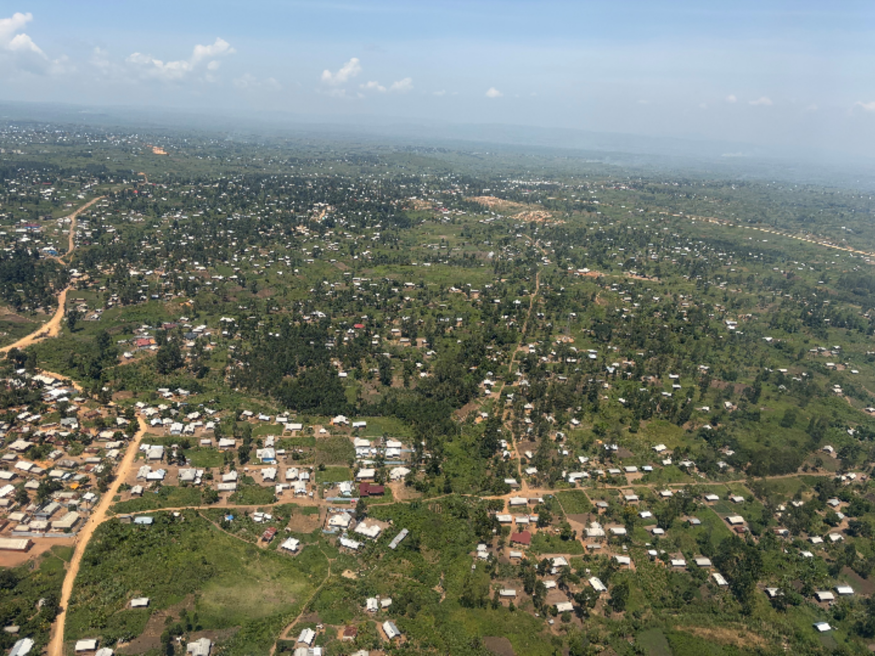
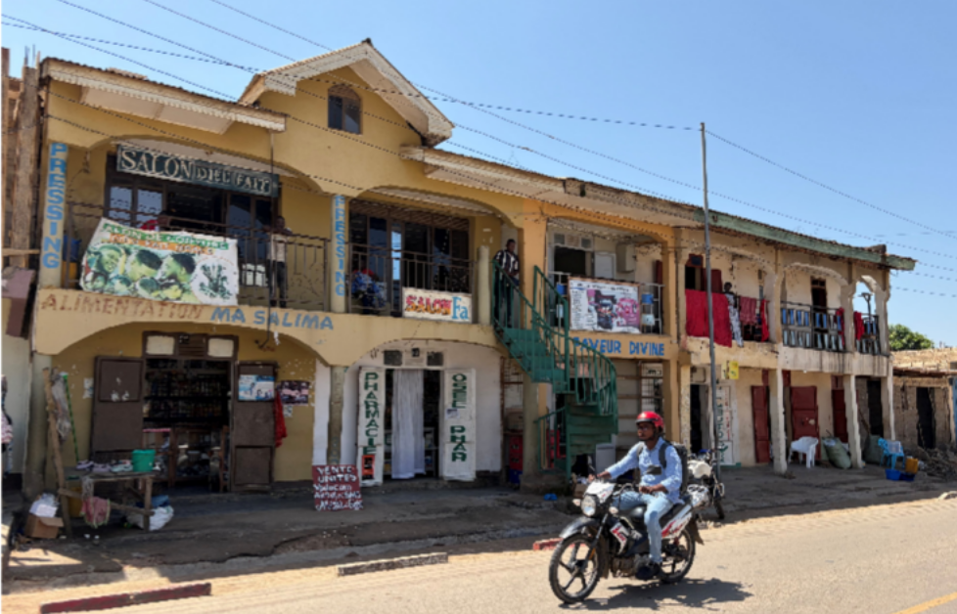
Picturesque Bunia – epicentre of the epidemic
As I left Bunia - a resilient small city - I appreciated the huge difference a small group of committed people are making in Bunia.

